Slide 1
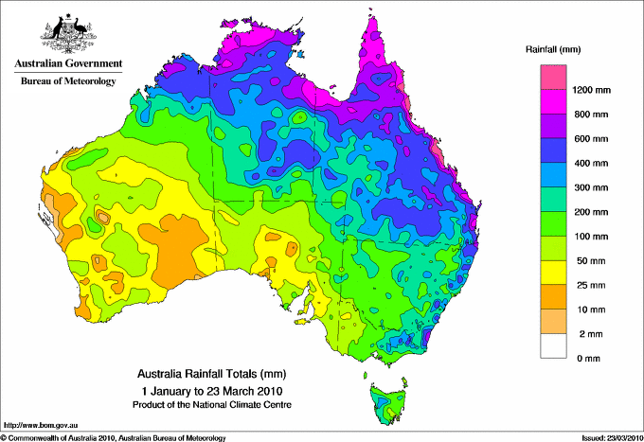
How can water quality be threatened?
L/O: To explain the different types of threats facing water quality and evaluate how severe they can be.
Categorise the impacts of climate change on rich and poor countries.
Starter:
Describe the pattern of rainfall in Australia (2 marks)
To describe the different pollutant sources and the impacts they have on water quality.
To explain how agriculture and sewage can have an impact on water quality and avalibility.

Slide 2
How are the effects of climate change different for poor and rich countries?
Effects of climate change in wealthy countries (MEDCs) | Effects of climate change in poor countries (LEDCs)
Can afford to irrigate crops and so provide food
Can afford to import food and therefore `virtual water’
May have to rely on dirty or unreliable sources of water
Changes in weather patterns could lead to water insecurity
Population may rise rapidly so more people affected by water and food insecurity
Can afford to build desalinisation plants to get drinking water from sea water
Farmers rely on rain to water crops, which could lead to food insecurity and famine
Stretch Yourself: Which one (MEDC or LEDC) will suffer the most negative impacts from climate change? Give reasons why.

Slide 3
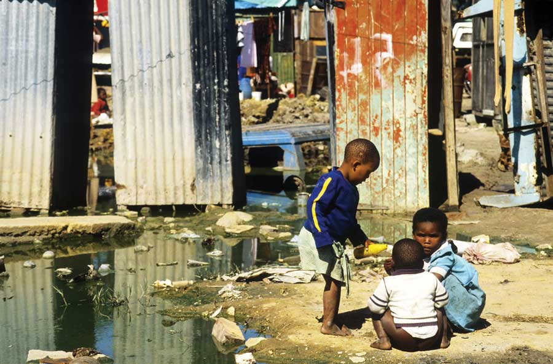
What problems do these children face from water supply and pollution?

Slide 4
What’s the difference?
Not only do we need enough water for everyday use, but the quality of the water is just as important as the quantity. People can suffer water stress if their water is not safe or is contaminated.
Sources of Pollution | Definition of the source
Domestic | Water that has been contaminated at home or through systems to manage waste, e.g. sewage systems.
Industrial | Where pollution has been caused through factories or collecting material to be used in industry, e.g. disposal of hazardous waste.
Agriculture | Where fertilisers, pesticides or irrigation has contaminated the water through seepage, e.g. excessive fertiliser use.
Transport | The movement of material causing pollution to water.
Other | Elements such as weather playing a role in moving pollutants around.

Slide 5
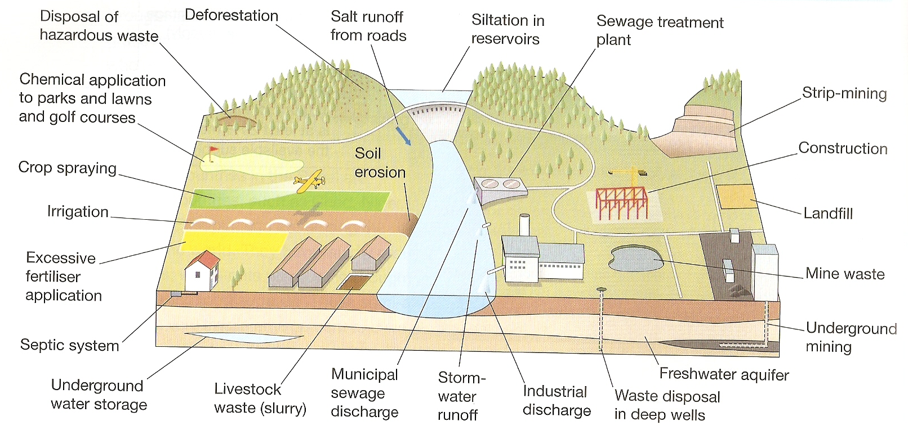
Task:
On your table classify all the pollutants from the diagram above under the headings Domestic, Industrial, Agricultural and Transport .

Slide 6
Intensive Agriculture
Agriculture uses around 70% of the world’s water, particularly in developing countries who rely on farming for income.
Task:
Make a copy of the graph and annotations from page 67 (use a ruler and pencil to draw the graph).
Why do you think countries like Japan and the UK have good water supplies and quality?
There are 2 main types of intensive agriculture. Using page 67, make key notes on chemical agriculture and solid agriculture.

Slide 7
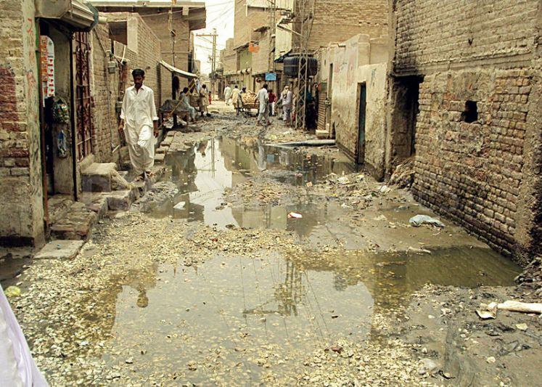
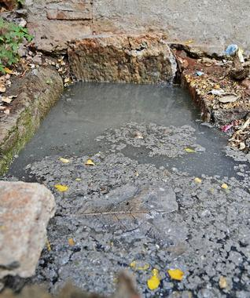
Sewage Disposal Answer the questions below in full sentences.
What is happening in mega-cities?
What has happened to some of the streams flowing through these cities?
What do people use these rivers for?
What problems can this water cause for people and animals?

Slide 8
Using examples, explain how pollution threatens water quality (6 marks)
Water can be polluted by domestic, industrial and agriculture activities. Sometimes waste from sewage combines and mixes with fresh water. This mainly in developing countries, this is because they don’t have money or the technology to build effective sewers. Another way that water can be polluted is by acidic rain that is made by factories and burning fossil fuels. In China, they are opening 1 coal fired station each week, increasing the amount of carbon dioxide in the atmosphere.

Slide 9
Pollution in emerging countries…
Levels of water pollution can be related to economic development. The highest levels of water pollution are usually linked with rapid growth – in countries such as China and India.
These countries are industrialising and developing their energy sources rapidly. They tend to put economic growth before environmental concern. Countries like this are also experiencing rapid urban growth, infrastructure can not cope.
As a result, streams that run through slums and shanty towns are badly affected by pollution.

Slide 10
Pollution in emerging countries…
Many countries with rapidly developing economies are also developing commercial agriculture which relies on pesticides and fertilisers to increase yields. Runoff of those chemicals increases water pollution.
Developing countries tend to lack concentrations of larger countries, as a result streams and rivers are polluted.
Why do you think countries such as India and China not have standards for water quality?

Slide 11
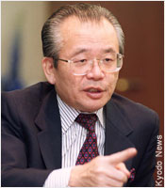
Minamata Mystery
Mr. Susaki is a 45yr old businessman with a wife and 3 children.
He has been living in the Japanese city of Minamata all of his life.
However, last year something started making Mr. Susaki ill. He has lost his balance, is unable to write and has no coordination. The doctors have struggled to diagnose him…
We are going to explore what is making Mr. Susaki ill.

Slide 12
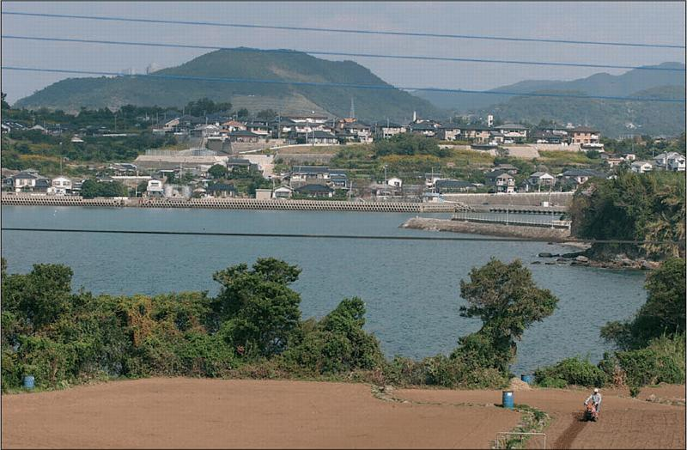
What do you think is making Mr. Susaki ill?
What is making Mr. Susaki ill?

Slide 13
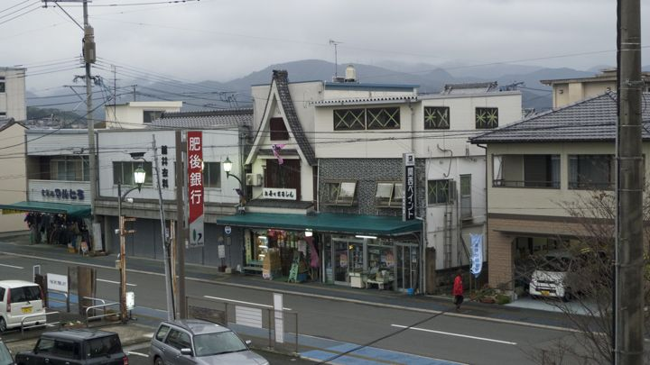
What do you think is making Mr. Susaki ill?
What is making Mr. Susaki ill?

Slide 14
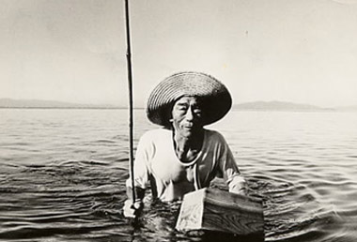
Over to you!
Investigation Time
Read the boxes on the sheet in front of you. They tell the story of what happened in Minamata.
Using 3 coloured pencils piece together the story. Shade in boxes into the following categories…
Symptoms
Causes
Consequences
Using the hand-out, highlight or underline any key information as to what is making the patient ill.

Slide 15
What is making Mr. Susaki ill?
You are now going to answer the question above using all the information that you have collected in today’s lesson. You can also link the work from Friday’s lesson also.
Use the sentence starters to help you.
There are many problems facing Mr Susaki and his people and they are …..
The symptoms Mr Susaki experienced were ….. and I think the most severe symptom was …… I think this because …..
The cause of Mr Susaki’s symptoms were ……
These happened because …..
As a result, the consequences were …..

Slide 16

HEAD-something that has made you think
HEART- something that you have felt
BIN-something you did not find interesting
BAG- something you will remember and take away
Bin

Slide 17
HEAD
HEART
BIN
BAG
Bin

